Slide 1

DoGO Digital a mini project to be major by Kamran Ali
Project PPTS
Technologies Used : Html , Css , javascript

Slide 2
Information
Project Name -> DoGO Digital
Discription –> DoGO Digital is a mini project made for the convenience banking with features of online banking accessed with the user id and password, costumer can create account with the help of their phone number linked with the bank, email id upi and more… I have also added interest calculator option for the costumers so that they can think of availing loan !

Slide 3
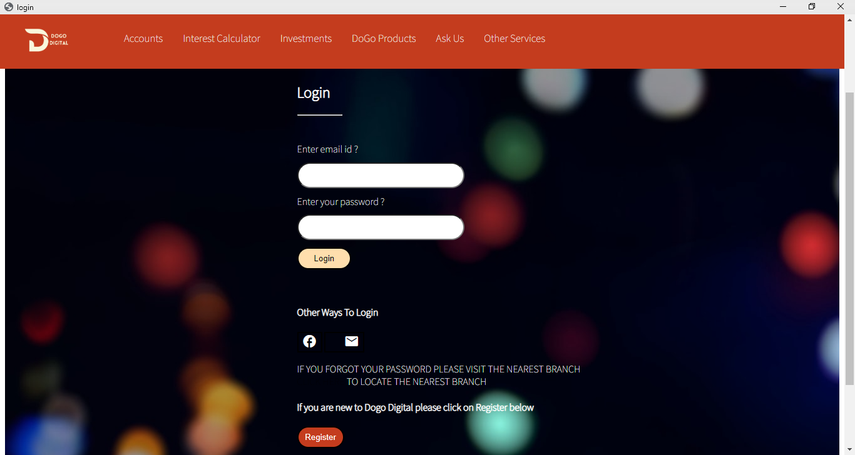
Login Page

Slide 4
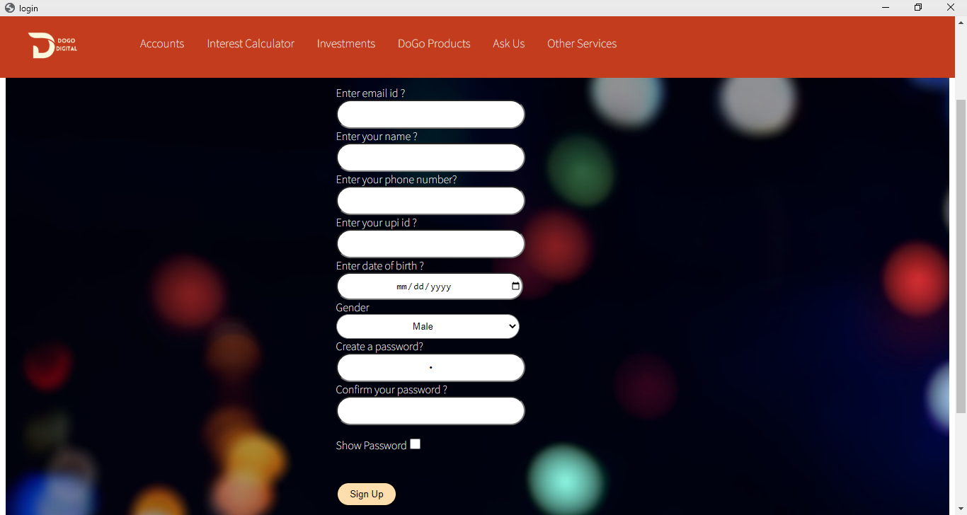
Registration Page

Slide 5
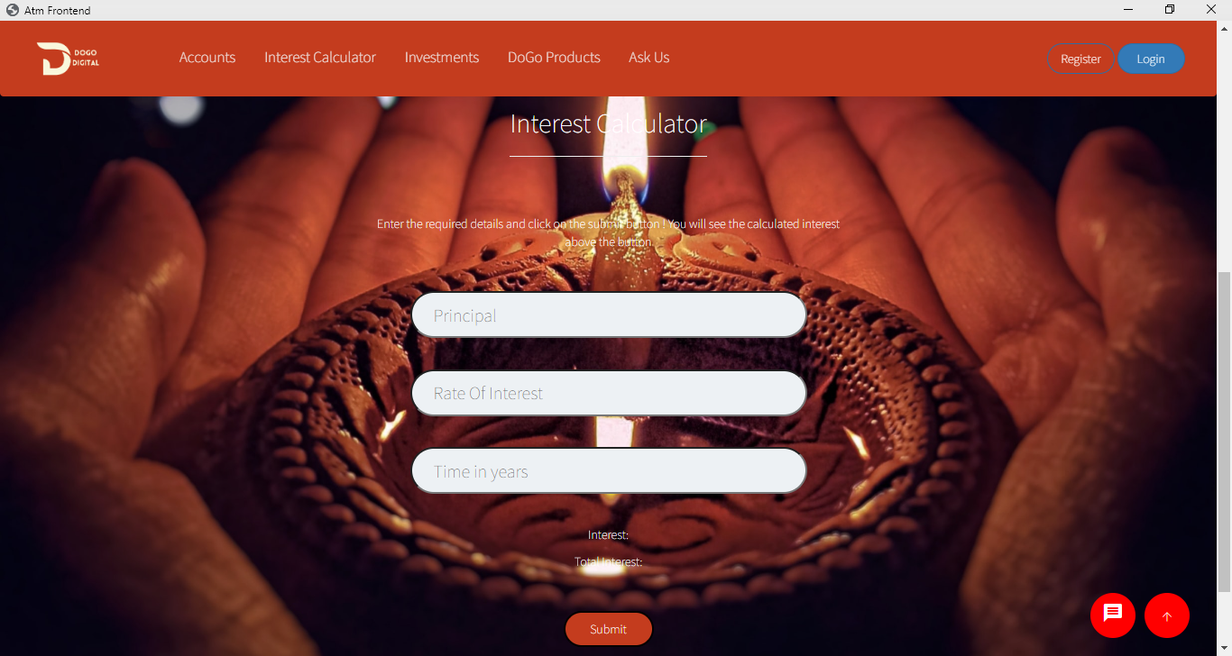
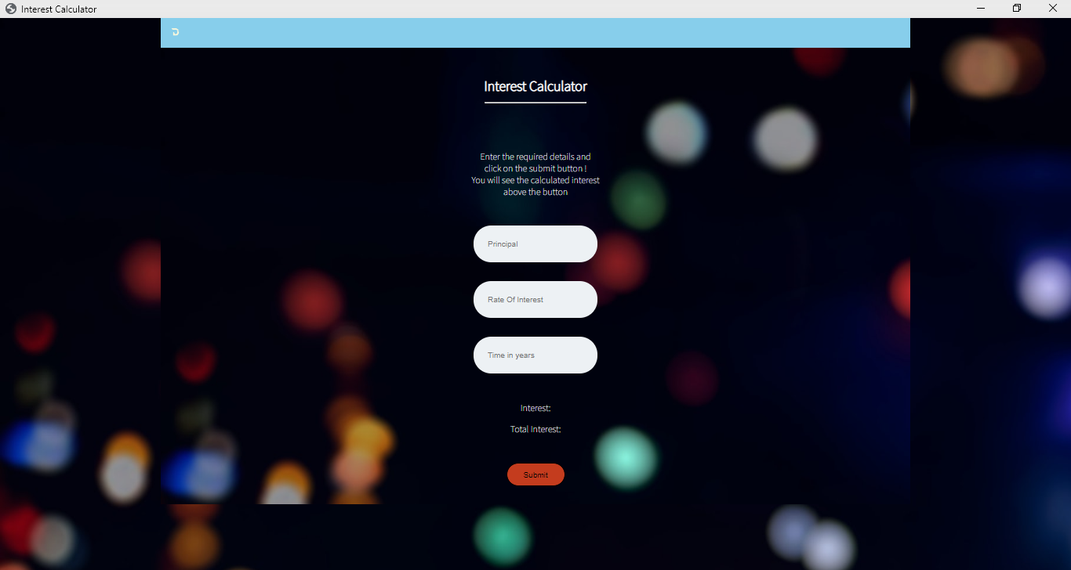
Interest Calculator

Slide 6
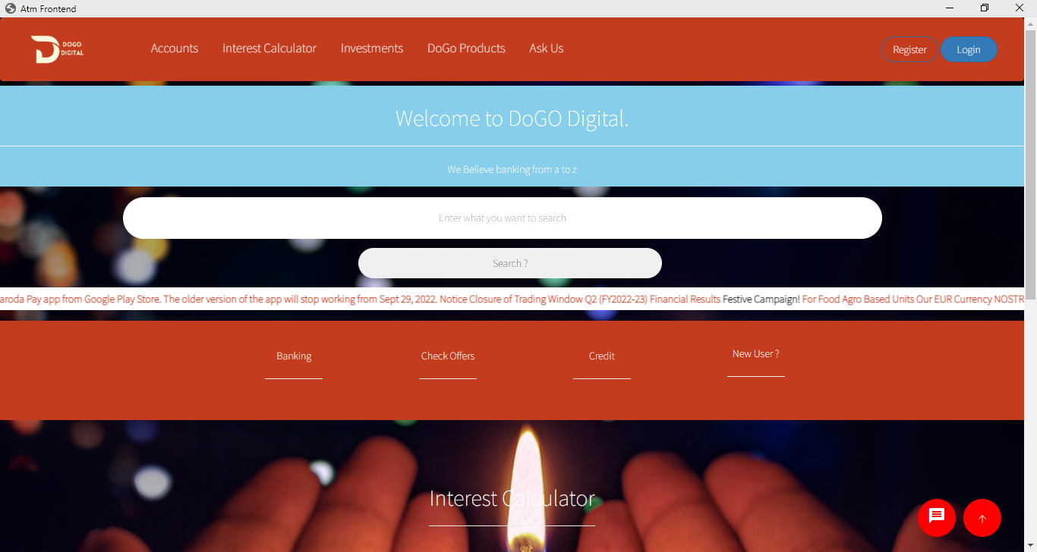
Home Page

Slide 7
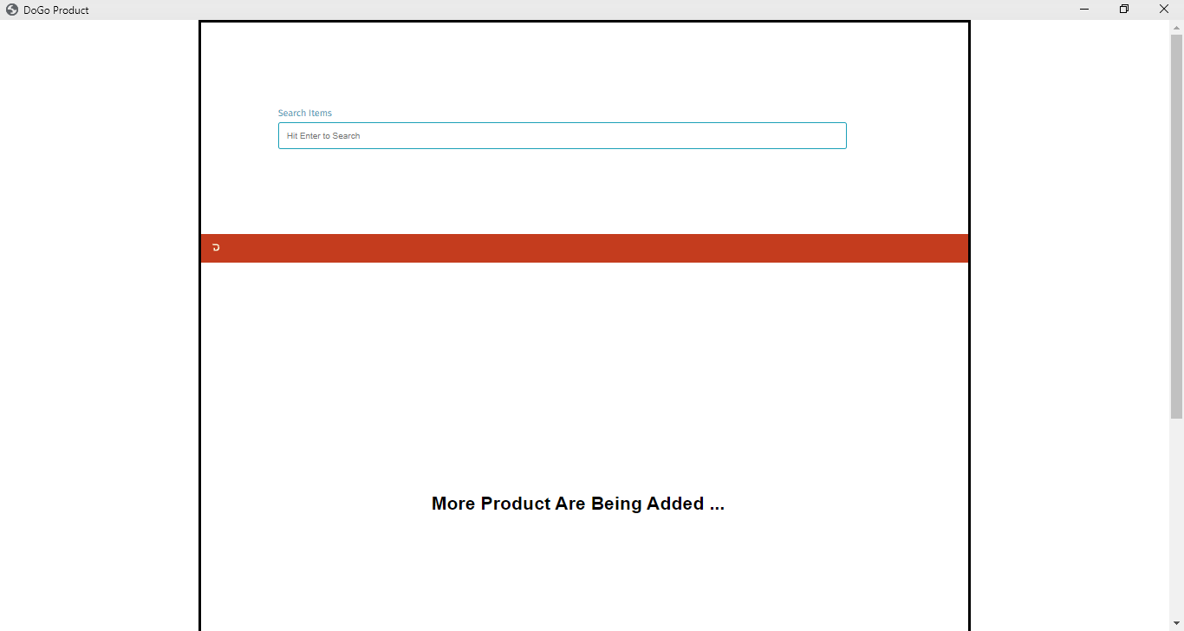
DoGO Products

Slide 8
Vission
To make a proper banking website with a lot more features which includes Money Transfer , QR , DoGO Coin , Products etc..
To make it more responsive
To add database
To connect to the server
To enhance user experience
To Update frequently

Slide 9

Thank You !
Linkedin.com/kamran-aly
Github.com/kamuranaly

